Slide 1


Pax challenge @

Slide 2
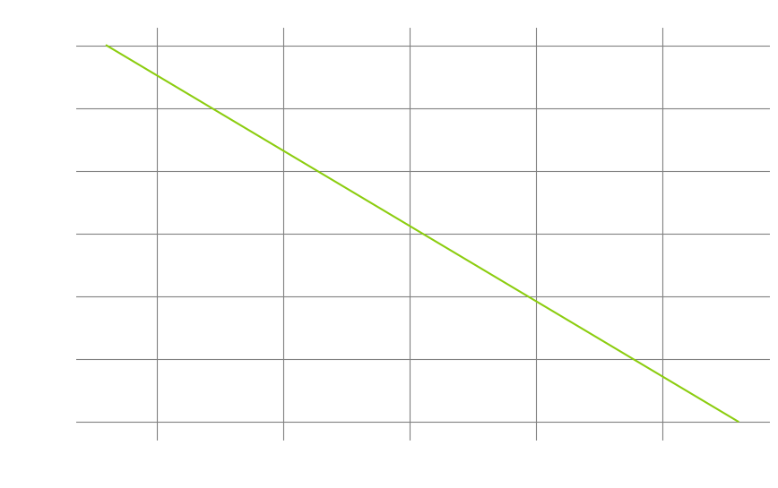
Challenges
Average age of life insurance buyers are 43 years old¹
Average monthly cost for life insurance is 100 CHF/month²
Average attention span is 47 seconds³
Younger generations do not have patience
Need a friendly way to interact
Why not have a central index of truth?
BEAR FACT:
A 71-year-old woman from California, became the state's first recorded fatality from a black bear attack.
https://lewisellis.com/industries/life-insurance-annuities/the-characteristics-of-people-who-buy-life-insurance/
https://en.comparis.ch/lebensversicherung/default
https://www.apa.org/news/podcasts/speaking-of-psychology/attention-spans
Notes:
Why did we choose the challenge?

Slide 3
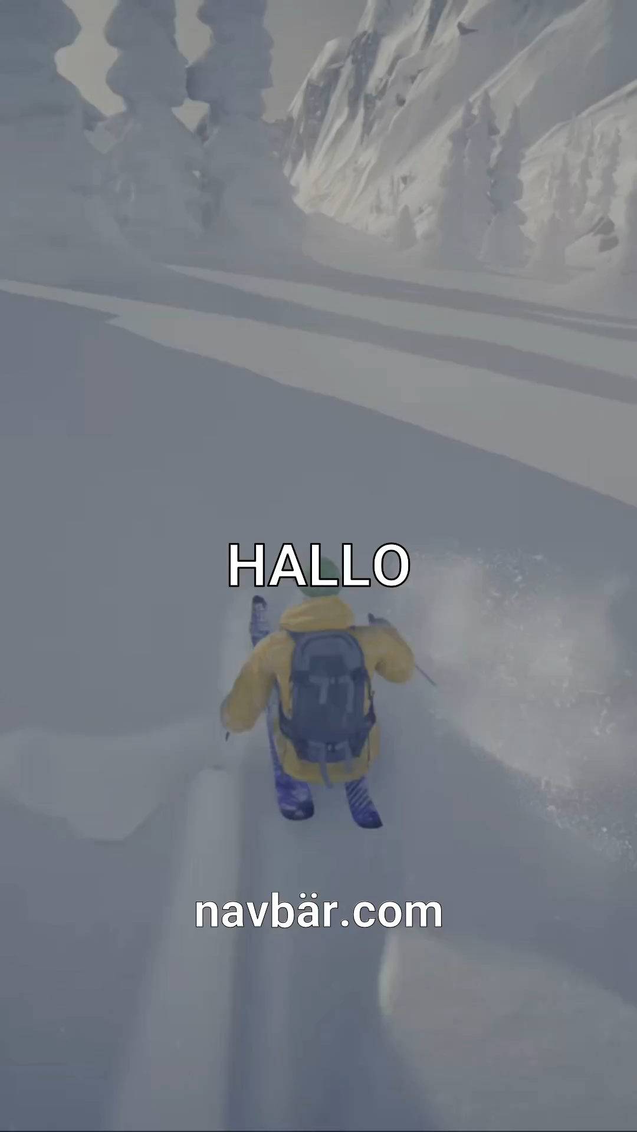

How do we get attention?
Targetted ads using TikTok¹
Gender
Age: 18-24, 25-34, 35-44 (our targets)
Location (specific as city): Basel
Interests (tailored videos)
Cell phone carrier: insure living in CH
Automatic AI generated videos →
BEAR FACT:
A teenager in Romania was mauled to death by a bear
while hiking in the Bucegi mountains.
https://ads.tiktok.com/help/article/ad-targeting

Slide 4

ChatAVB.com
Chat with NAVBÄR now →
Private user specific sessions
No saved data (GDPR by default)
What are we offering from PAX?
Disability insurance
Life insurance
Savings life insurance
Children's insurance
Payout plan
BEAR FACT:
The "Ninja Bear," officially designated as "OSO18," was notorious in Japan's Hokkaido region
for attacking dozens of cows and evading capture for years

Slide 5

What is NAVBÄR?
Friendly chat bear to understand and choose the right insurance
Indexed webpage and documentation to provide detailed responses to questions
Microsoft AI search
ChatGPT 4o
RAG
BEAR FACT:
Grizzly No. 399, a beloved bear in Grand Teton National Park, was killed by a vehicle,
leading to a community vigil in her honor.

Slide 6
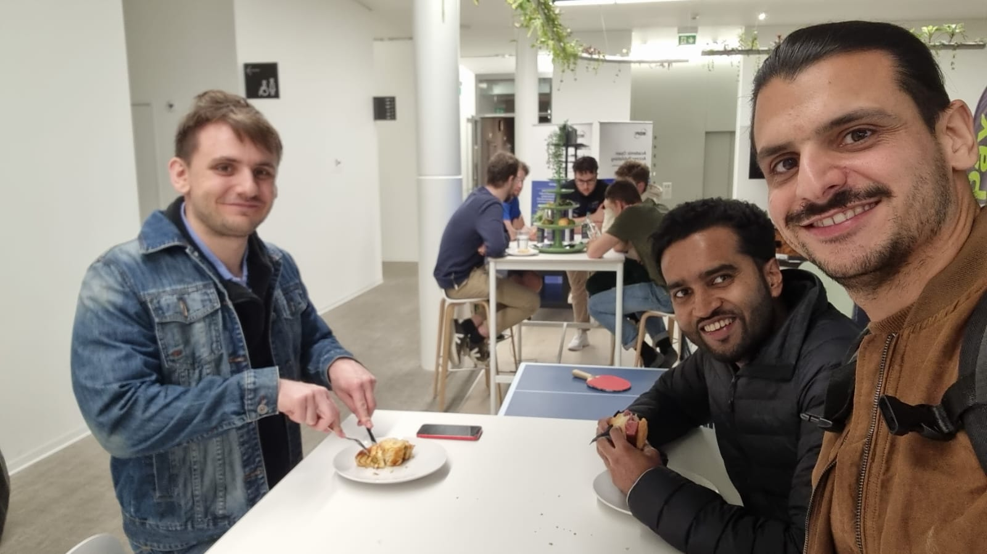
Team
Fabrizio Parrillo
Alex Rovner
Niluka Piyasinghe
Normand Overney
Kevin Yar
BEAR FACT:
Hugh Glass, a 19th-century fur trapper, survived a grizzly bear mauling and crawled over 200 miles to safety,
inspiring the film "The Revenant."

